Slide 1

Design Review
Zak Rowland

Slide 2
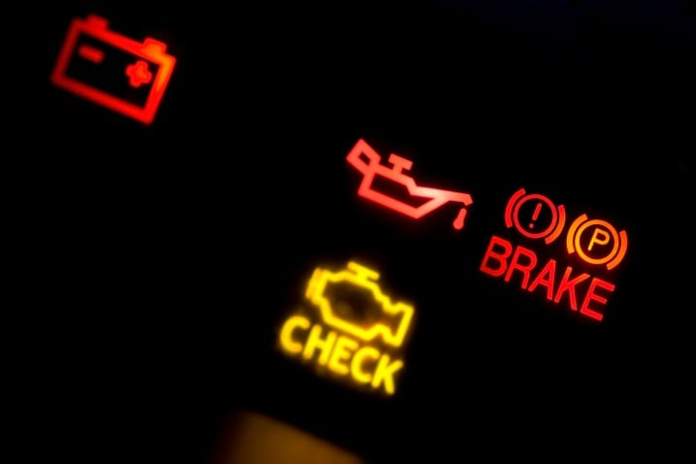
What is it? Why build it?
Bluetooth OBD-II diagnostic tool with rechargeable touchscreen handheld
Diagnose check engine lights or other malfunctions
Monitor speed, temperatures, and pressures
Perfect for home mechanics or hobbyists, professionals too
Low cost and open source
Source

Slide 3
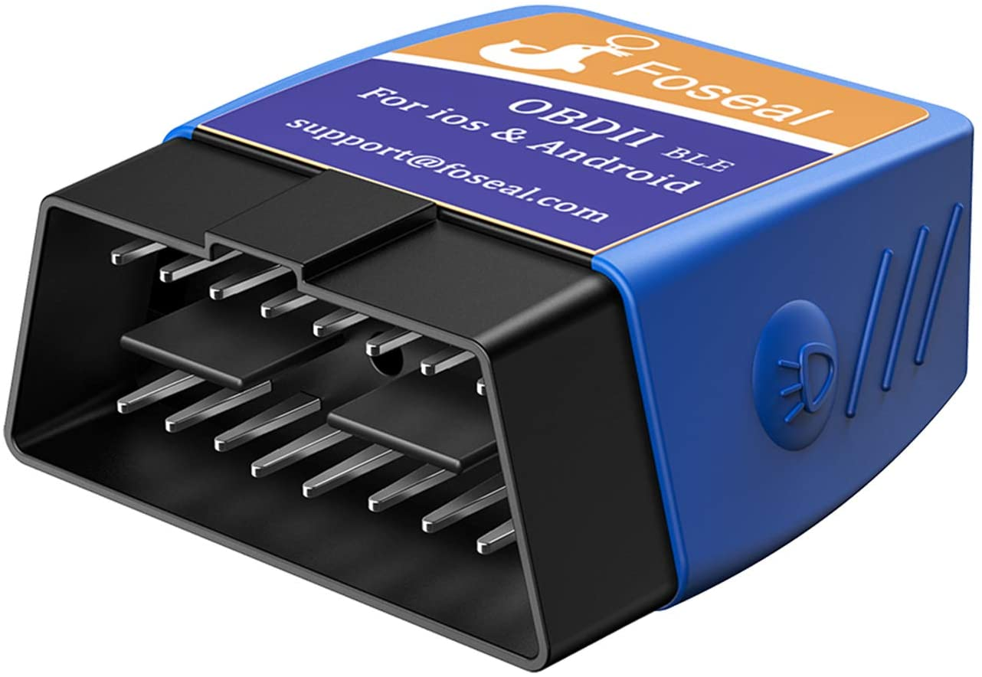
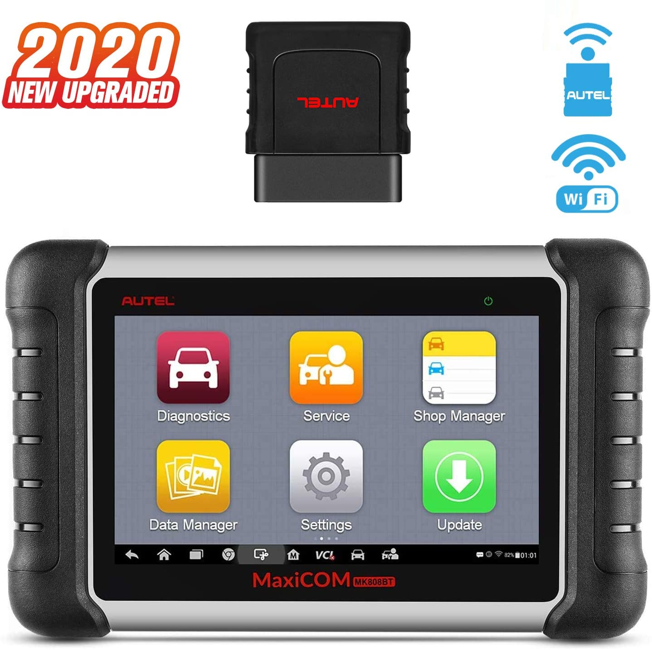
How is it different?
Commercial options:
Cheap Bluetooth readers
Made to connect to phone apps
Likely uses a clone of the real IC
Expensive Wi-Fi or Bluetooth readers
Costly, easily $500 or more
Tailored more towards professionals
Bloated with features
Source
Source

Slide 4
How is it different? (continued)
Existing projects:
“OBD-Pi”
Uses prebuilt OBD-II Bluetooth reader
Uses aftermarket stereo head unit for display
“M3 Pi”
Uses prebuilt OBD-II Bluetooth reader with different interpreter (STN1110 vs. ELM327)
Touchscreen and Raspberry Pi embedded permanently into dash
My project:
Custom OBD-II circuit
Wireless, rechargeable, touchscreen handheld
All schematics, documents, and code open source
OBD-Pi
M3 Pi

Slide 5
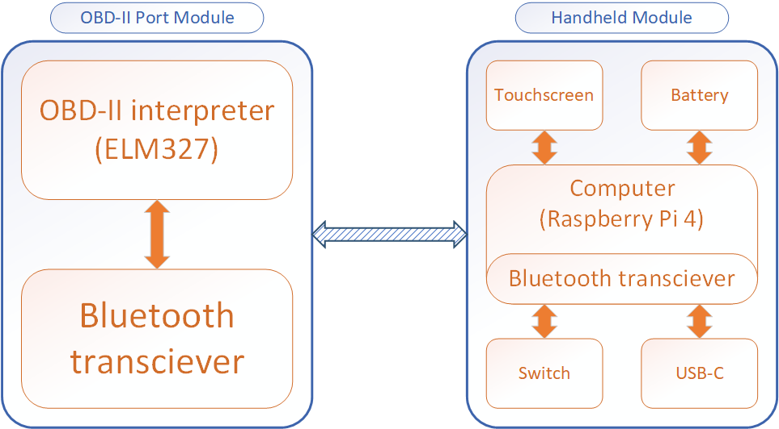
System Block Diagram

Slide 6
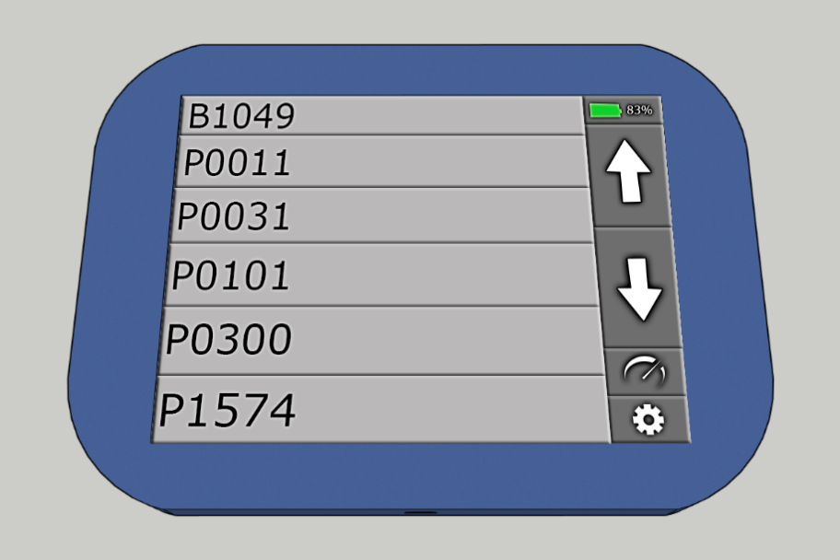
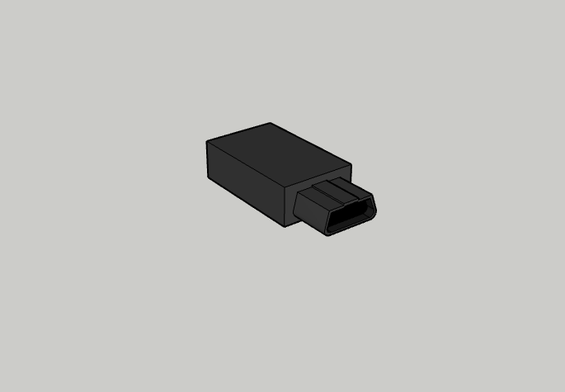
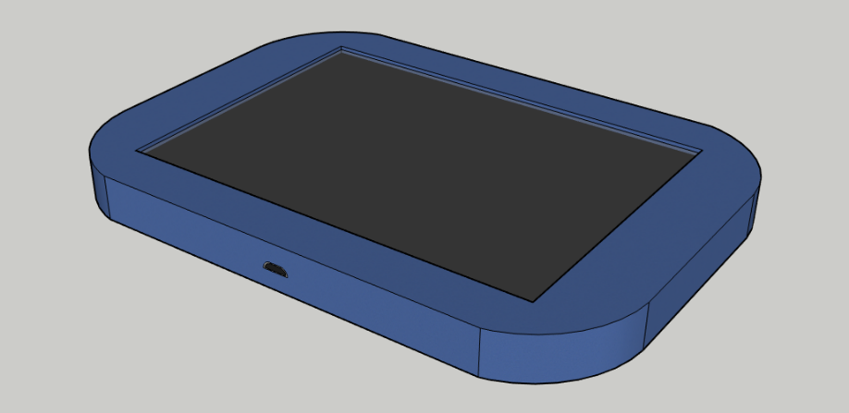
What will It look like?

Slide 7
Functionality and Features
Read and clear diagnostic codes
Tap on a code to read description
Read and display information like speed, pressures, and temperatures
Touchscreen and rechargeable
USB-C charger
Battery level indicator
Bluetooth 4.0+

Slide 8
Requirements
1. The system shall work with the 2008 Nissan Altima OBD-II protocol, ISO15765-4 (CAN-BUS.)
Other vehicles that use the same protocol may work with the system, however it is not required.
4. The system shall use Bluetooth 4.0 or greater for data transfer.
a. The Bluetooth version shall be 4.0 or greater because previous versions do not support Bluetooth Low Energy (BLE.) The range of the connection is also improved with newer versions.

Slide 9
Component Selection – Computer
Name | Raspberry Pi 4 Model B | Raspberry Pi Zero W | BananaPi-M3
Price | $35 | $10 | $43
Processor | Broadcom BCM2711 (Quad core Cortex-A72 ARM v8), 64-bit, 1.5GHz | Broadcom BCM2835 (Single core ARM1176JZFS), 1GHz | Realtek RTD1395 (Quad core Cortex-A53), 64-bit
Storage | MicroSD | MicroSD | 8GB eMMC + MicroSD
Memory | 2GB LPDDR4-3200 SDRAM | 512MB | 1GB DDR4
Wireless | Wi-Fi and Bluetooth 5.0 | Wi-Fi and Bluetooth 4.1 | Wi-Fi and Bluetooth 4.2
I/O | (2) USB 3.0, (2) USB 2.0, (2) Micro HDMI, DSI, CSI, 3.5mm A/V, Ethernet | Mini HDMI, USB OTG, CSI, Composite video | (4) USB 2.0, M.2, 3.5mm, HDMI, Ethernet
GPIO | 40-pin | 40-pin | 28-pin
USB/Power | USB-C, 5V/3A+ | Micro-USB, 5V/2A+ | USB-C, 5V/2A+
Other | OpenGL ES 3.0 graphics |  | OpenGL ES 1.1/2.0 graphics
Why Pi 4?
Already owned
Well documented
Generous I/O
DSI display
Bluetooth 5.0

Slide 10
Component Selection – OBD-II interface
Name | ELM327 | STN1110
Price | $21 | $10
Operating voltage | 4.5 – 5.5VDC | 3 – 3.6VDC
Operating current | 12mA | 63mA
Power saver mode | 0.15mA | <2mA
Operating power | 60mW at 5V | 207.9mW at 3.3V
Power saving power | 0.75mW at 5V | 6.6mW at 3.3V
Features | Power control with standby mode Serial interface Automatically searches for correct protocol Fully configurable with AT commands Low power CMOS design Very popular and well documented | Fully compatible with the ELM327 (AT) command set Extended (ST) command set UART interface Automatically searches for correct protocol Large memory buffer (more RAM) Voltage input for battery monitoring
Cons | Expensive Many buggy fakes/clones if not purchased from manufacturer | Less documentation and examples Uses more power
Why ELM327?
Popularity
Documentation
Low power consumption

Slide 11
Component Selection – Bluetooth
Name | HC-05 | HC-06 | HM-19
Price | $7.99 | $7.39 | $9.99
Bluetooth version | 2.0 | 2.0 | 5.0
Operating voltage | 3.6 – 6VDC | 3.3VDC | 3.6 – 6VDC
Logic voltage | 3.3V | 3.3V | 3.3V
Modes | Master/slave | Slave only | Master/slave
After lots of research, I decided to go with the ESP32. Why?
Used last year, will be easier for me to debug
Bluetooth 4.2
Same price as these Bluetooth modules

Slide 12
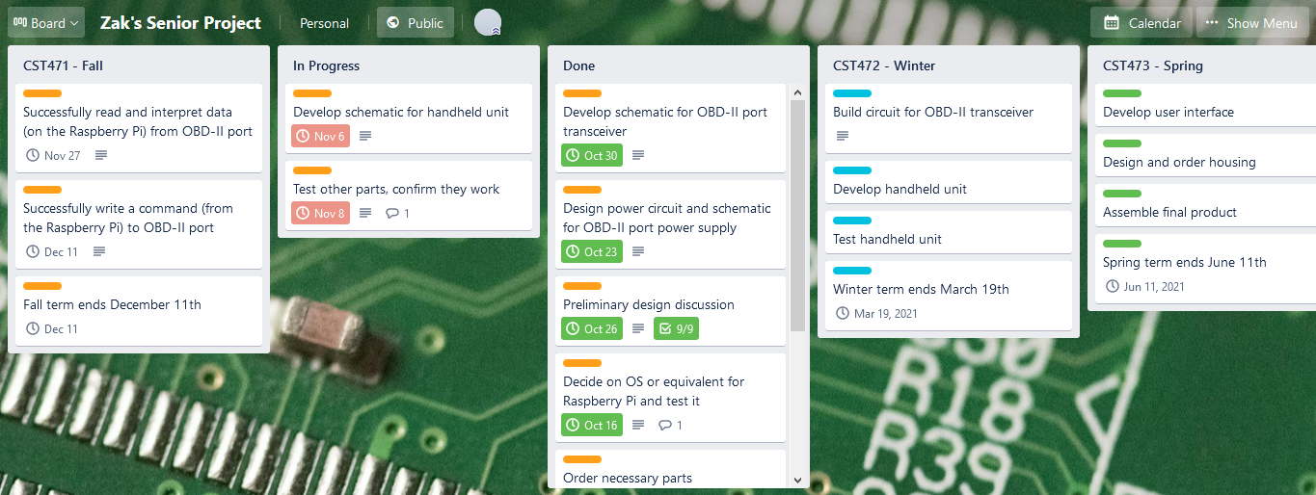
Schedule – Trello

Slide 13
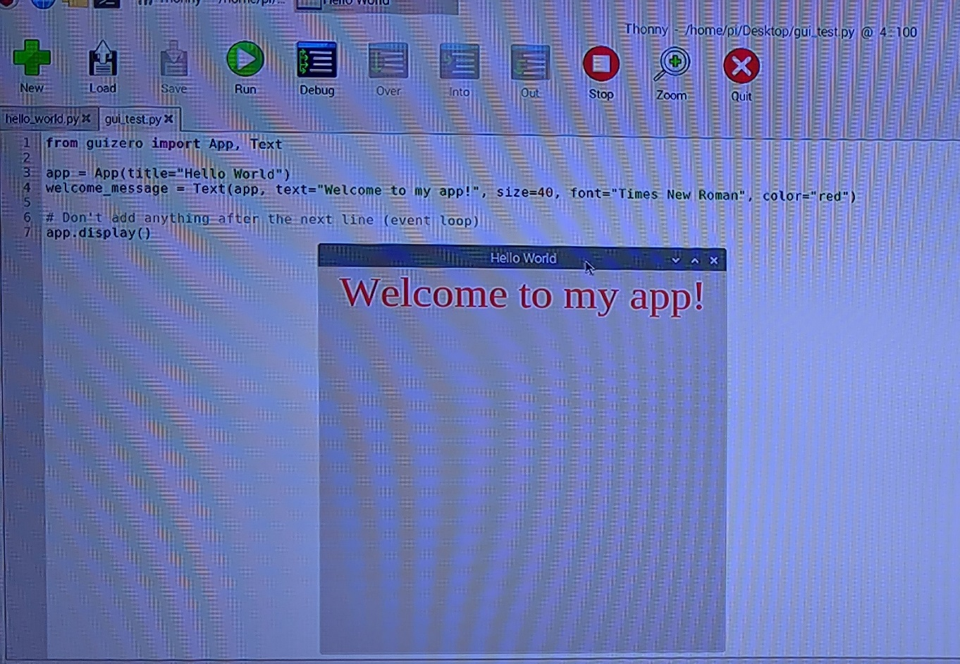
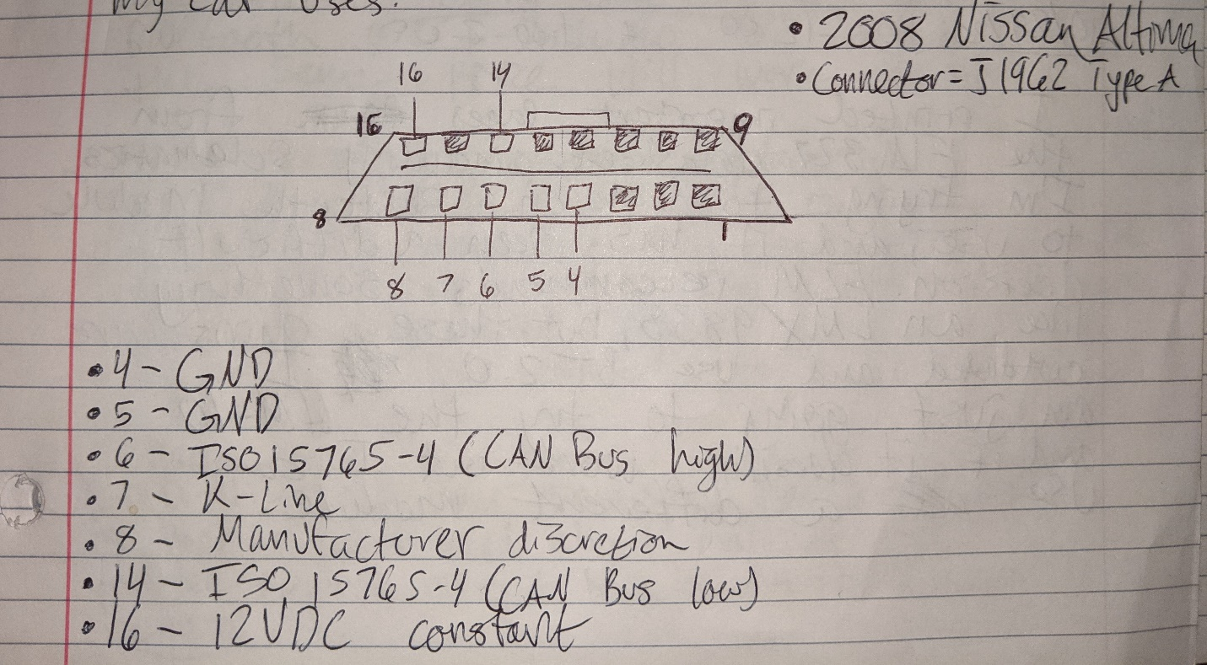
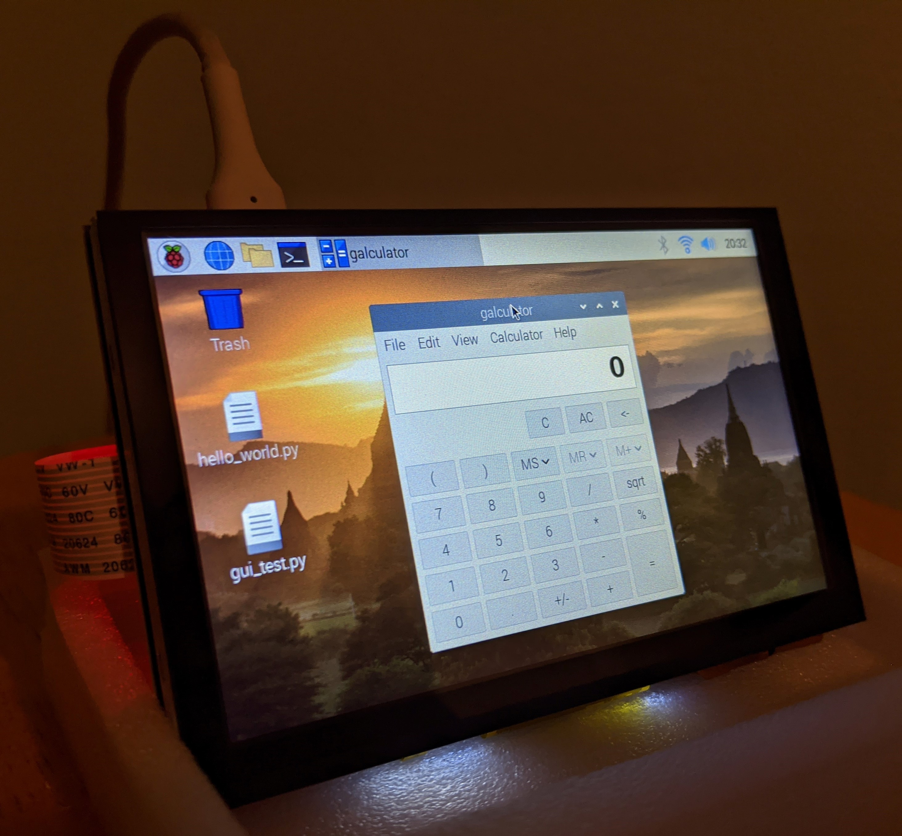
Progress so far
A lot of research and part selection
Installed OS on RPi4 and completed basic Python GUI tutorial
Documented pinout of my car’s OBD-II port
Tested touchscreen with RPi4

Slide 14
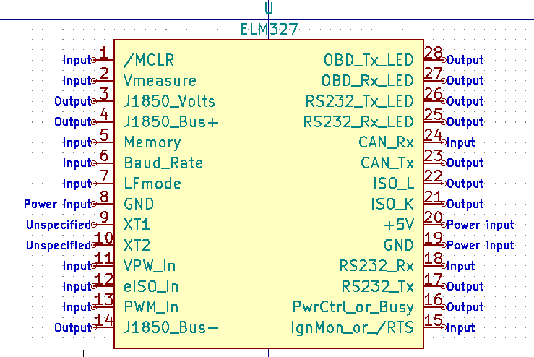
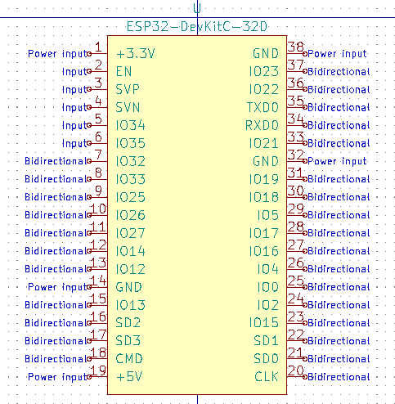
Progress so far (continued)
Creating a library of symbols
ELM327
OBD-II port
ESP32
etc.
Creating schematics
OBD-II module – done
Handheld module – in progress

Slide 15
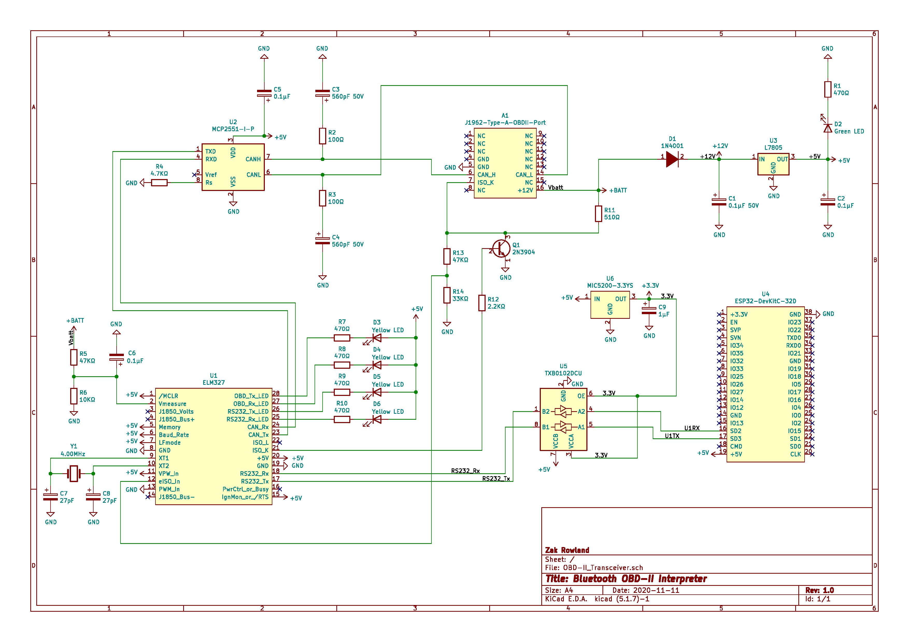

Slide 16
Demo

Slide 17
Questions or comments?

